Slide 1
Team 1
PenPal

Slide 2
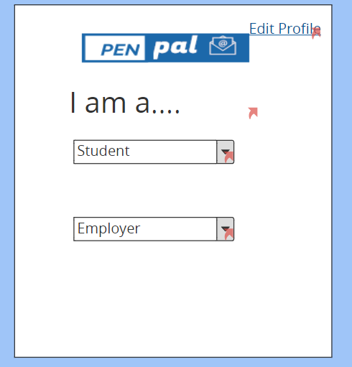
Confusion with I am a… page

Slide 3
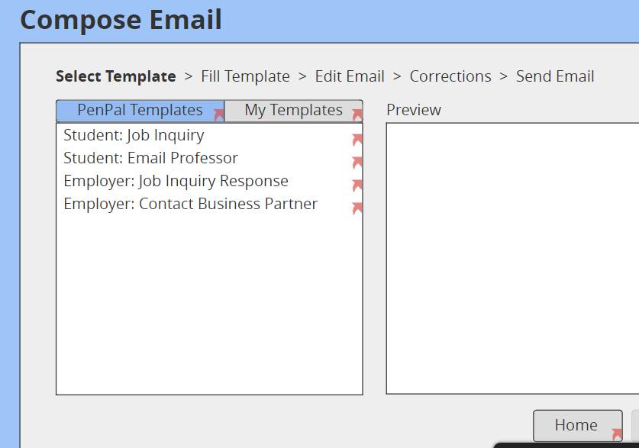
The fix and also show the user “Where am I”

Slide 4
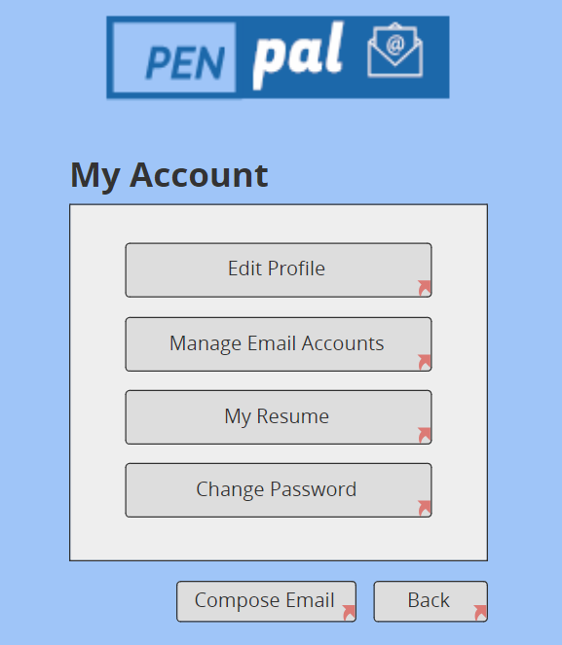
Compose Email on every page

Slide 5
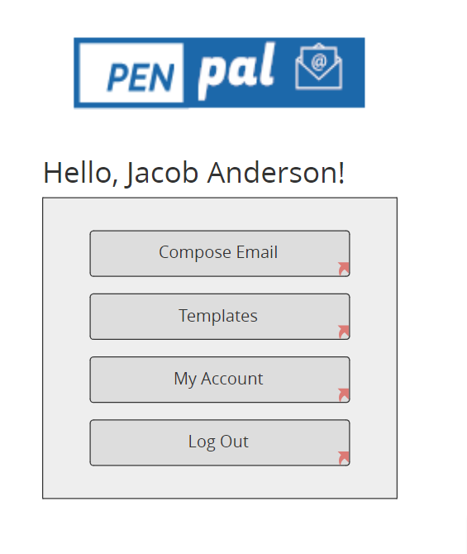
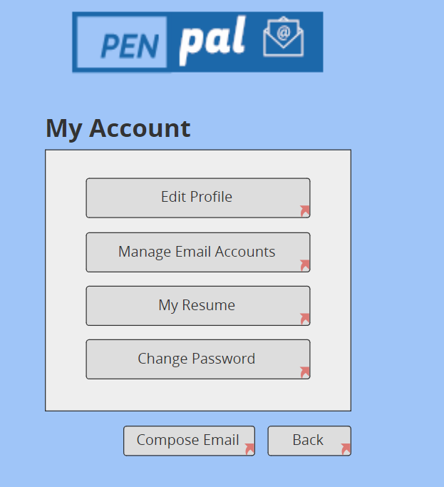
Inconsistent Color Theme

Slide 6
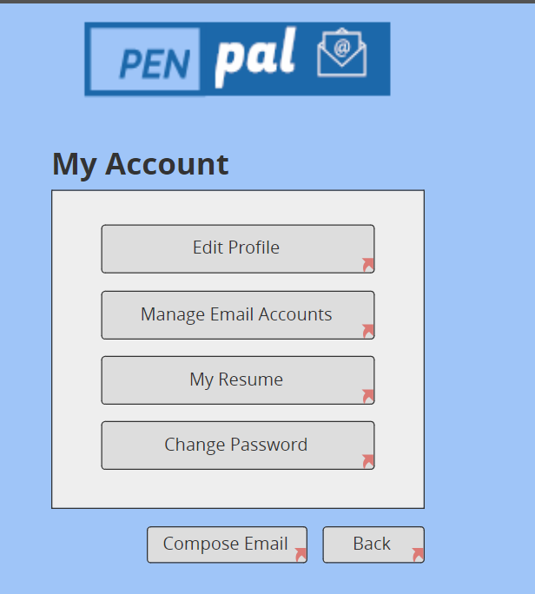
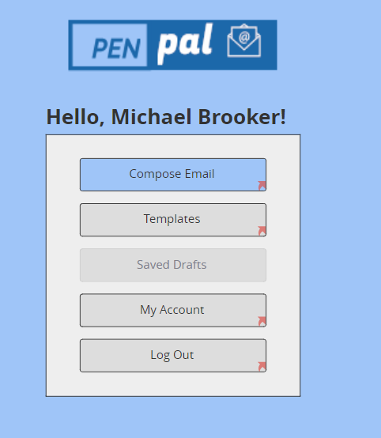
Fixed Color Theme

Slide 7
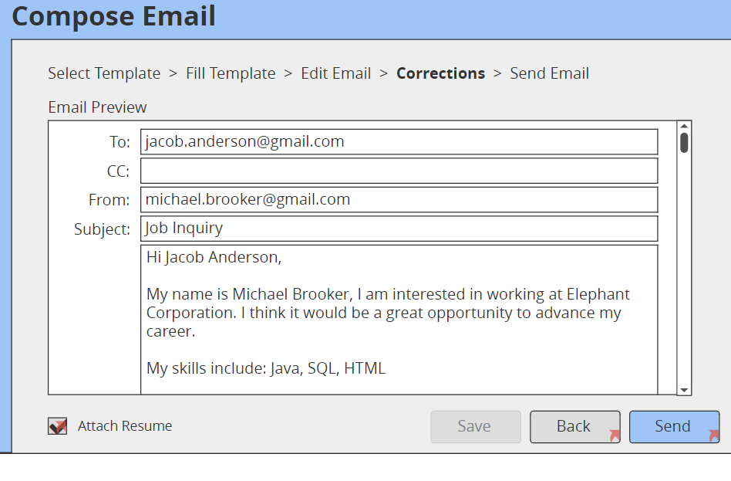
Ability to attach Resume

Slide 8
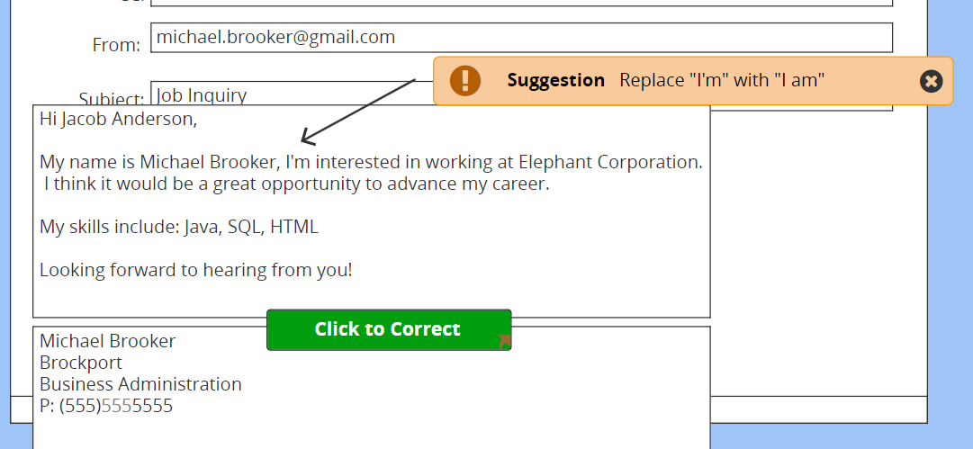
Original Spellcheck

Slide 9
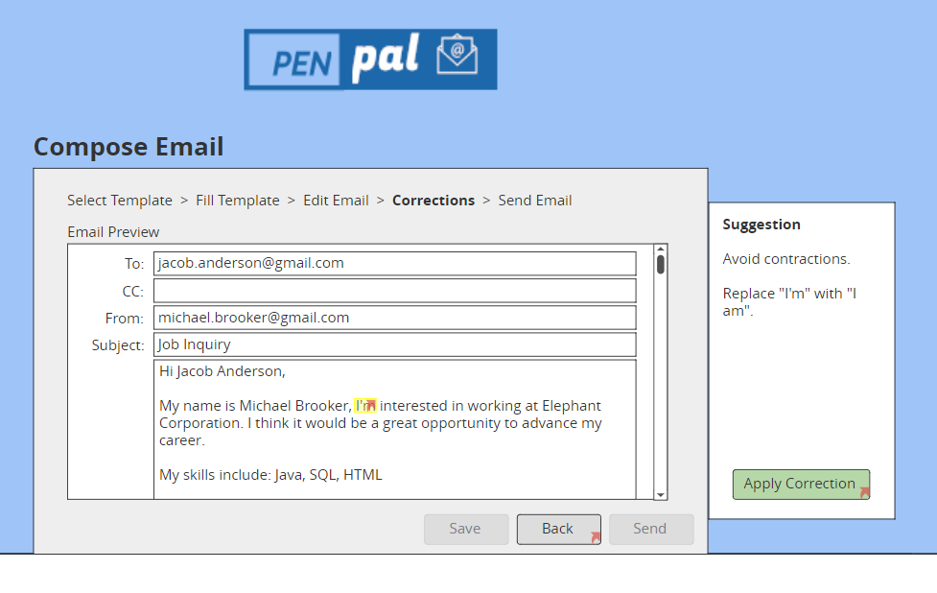
Updated Spellcheck

